Slide 1

Royal Dutch Shell
Marketing Management Presentation

Slide 2
Introduction
Shell plc is a British multinational oil and gas company headquartered in London, England.
Shell is a public limited company with a primary listing on the London Stock Exchange and secondary listings on Euronext Amsterdam and the New York Stock Exchange

Slide 3
History
Shell was formed in 1907 through the merger of Royal Dutch Petroleum Company of the Netherlands and The "Shell" Transport and Trading Company of the United Kingdom.
The combined company rapidly became the leading competitor of the American Standard Oil and by 1920 Shell was the largest producer of oil in the world.

Slide 4
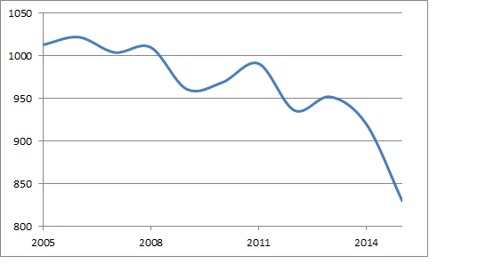
Statistics for Shell
The previous year, reduced transportation fuel demand following the coronavirus pandemic notably impacted the company's operations. In its 2020 fiscal year, Shell's revenue fell by nearly one half, reaching 180.54 billion U.S. dollars.
This Photo by Unknown Author is licensed under CC BY-SA-NC

Slide 5
Mission and Vision for Shell
Shell's purpose is to power progress together with more and cleaner energy solutions.

Slide 6
Marketing Mix
Shell uses majorly geographic segmentation strategies to collaboratively work with customers. Naturally being from the Oil industry, they have a product which is in demand everywhere. So they mainly have to concentrate on geographies to distribute their products.

Slide 7
Impact of Covid
Oil giant Royal Dutch Shell sank to a net loss of $21.7bn (£16bn) last year after the coronavirus pandemic caused demand to slump.
As a result, it said it might need to take measures to cut production.

Slide 8
Recommendations
We would suggest the target should be the only target, letting member states and industry choose the optimal energy and technology mix.

